Slide 1


Classifying Pseudoknots in RNA Using Graph Theory
REU Summer 2018
Benjamin Hermus
Mentor: Louis Petingi

Slide 2
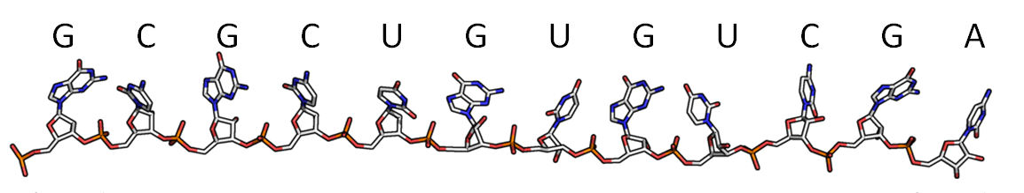
RNA Definition
Strands of genetic data
Used in numerous biological processes
Found in every living organism
Sequence of nitrogenous bases adenine, cytosine, guanine, and uracil.

Slide 3
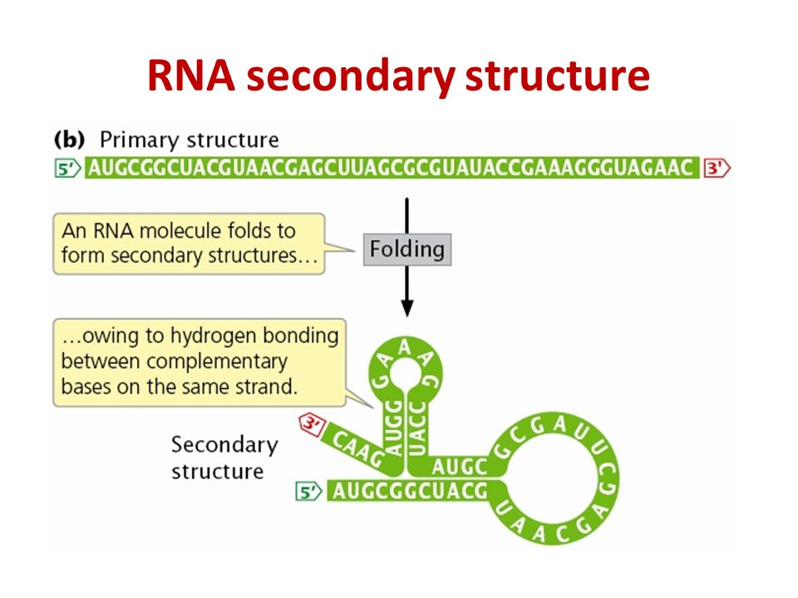
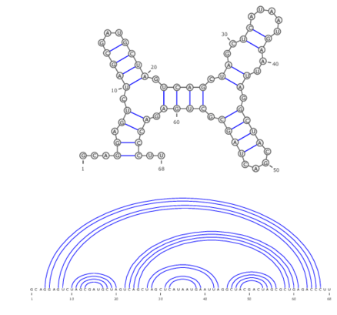
RNA Secondary Structure
Nitrogenous bases within RNA bond with one another
RNA folds over itself
Connections between bases form secondary structure

Slide 4
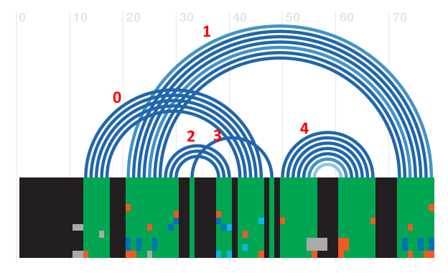
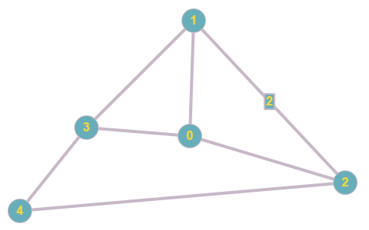
Representation Using Dual Graphs
Create dual graph representation using RNA arc diagram

Slide 5
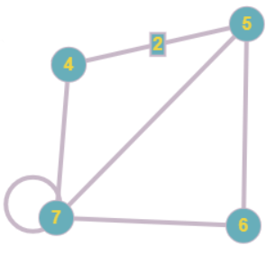
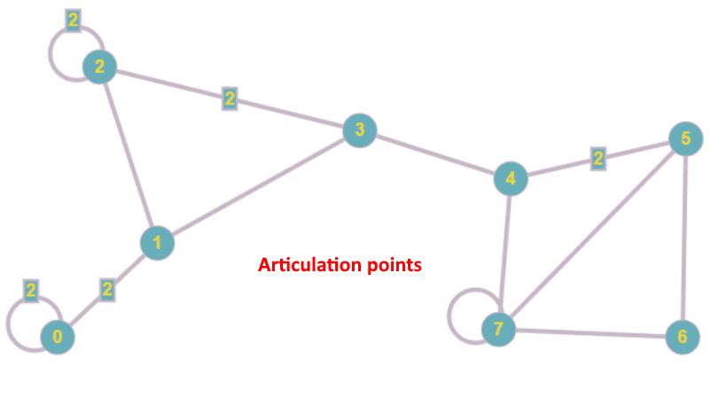
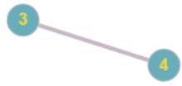
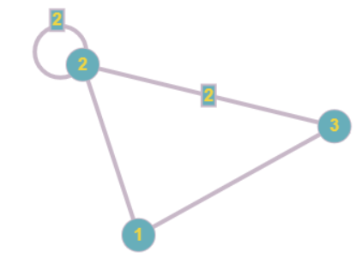
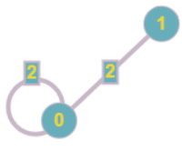
Tarjan Biconnectivity Algorithm
Divides graph into blocks using articulation points

Slide 6
Identifying Blocks as Pseudoknots
Any block with a vertex of degree 3 or greater indicates a pseudoknot (self loops are discounted)
Regular
region
Regular
region
Pseudoknot
Pseudoknot

Slide 7
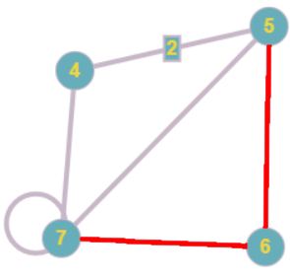
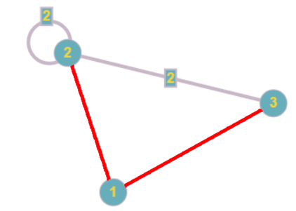
Identifying Recursive Pseudoknots
Extended program functionality to identify which pseudoknots are recursive
If removing two edges disconnects the block, the block is recursive
Recursive pseudoknot
Recursive pseudoknot

Slide 8

Example – RF00622
Program takes adjacency matrix as input

Slide 9
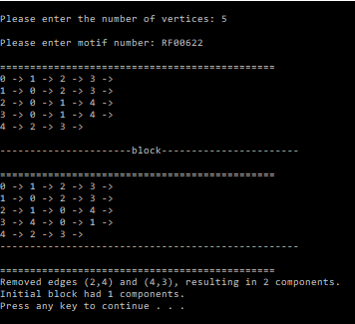
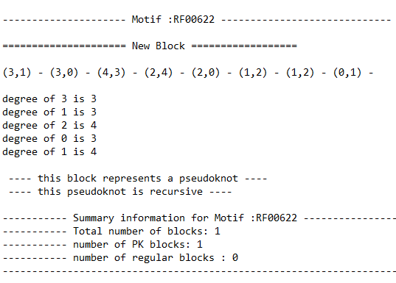
Example – RF00622
Outputs details of the motif into file
Additional information is returned via the console

Slide 10

Function isRecursive()
Begin with pseudoknot
Create subgraphs by removing two edges
For pseudoknot with e edges, there are $\sum_{i=1}^{e}{i}$ subgraphs
If any subgraph has more components than the initial pseudoknot, it is recursive

Slide 11

Function isRecursive()
g

Slide 12
Function isRecursive()
Choose a first edge to remove
Choose a second edge to remove
Create a new, empty Graph
g
}
Add edge only if not to be removed
If edge is to be removed but has weight >1,
add it anyways
Perform depth first search, keeping track of
number of connected components
If number of components has changed,
the pseudoknot is recursive

Slide 13
References
Petingi, Louis, and Tamar Schlick. “Partitioning RNAs into Pseudonotted and Pseudoknot-Free Regions Modeled as Dual Graphs.” Jan. 2016.

